Slide 1
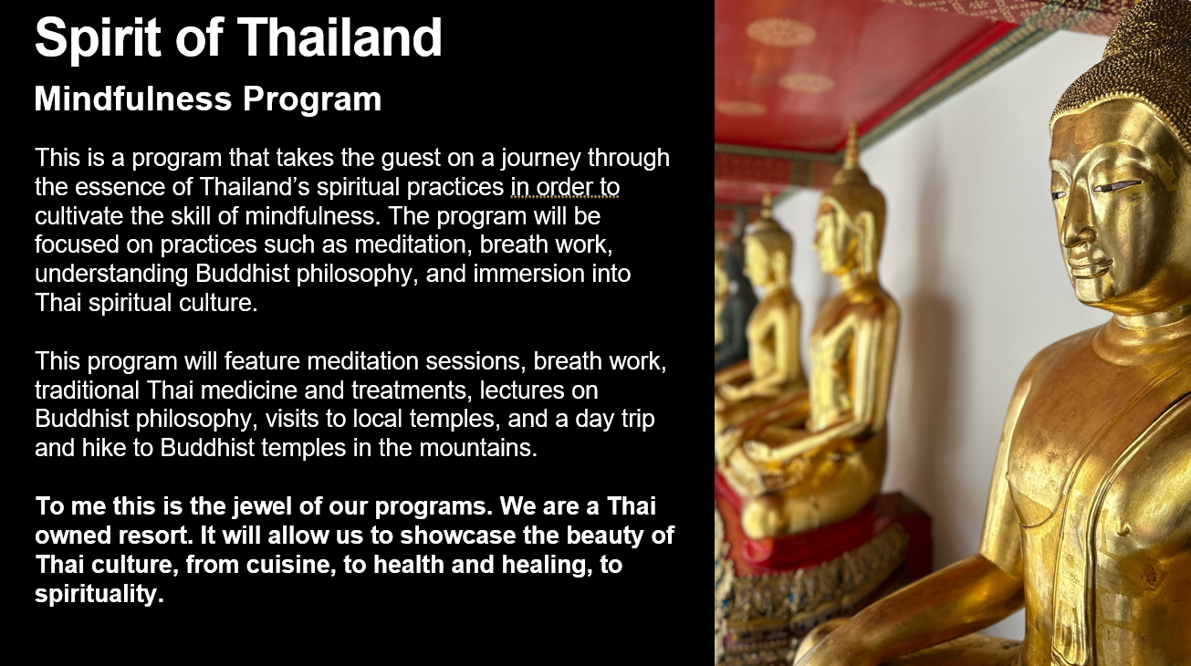

Slide 2
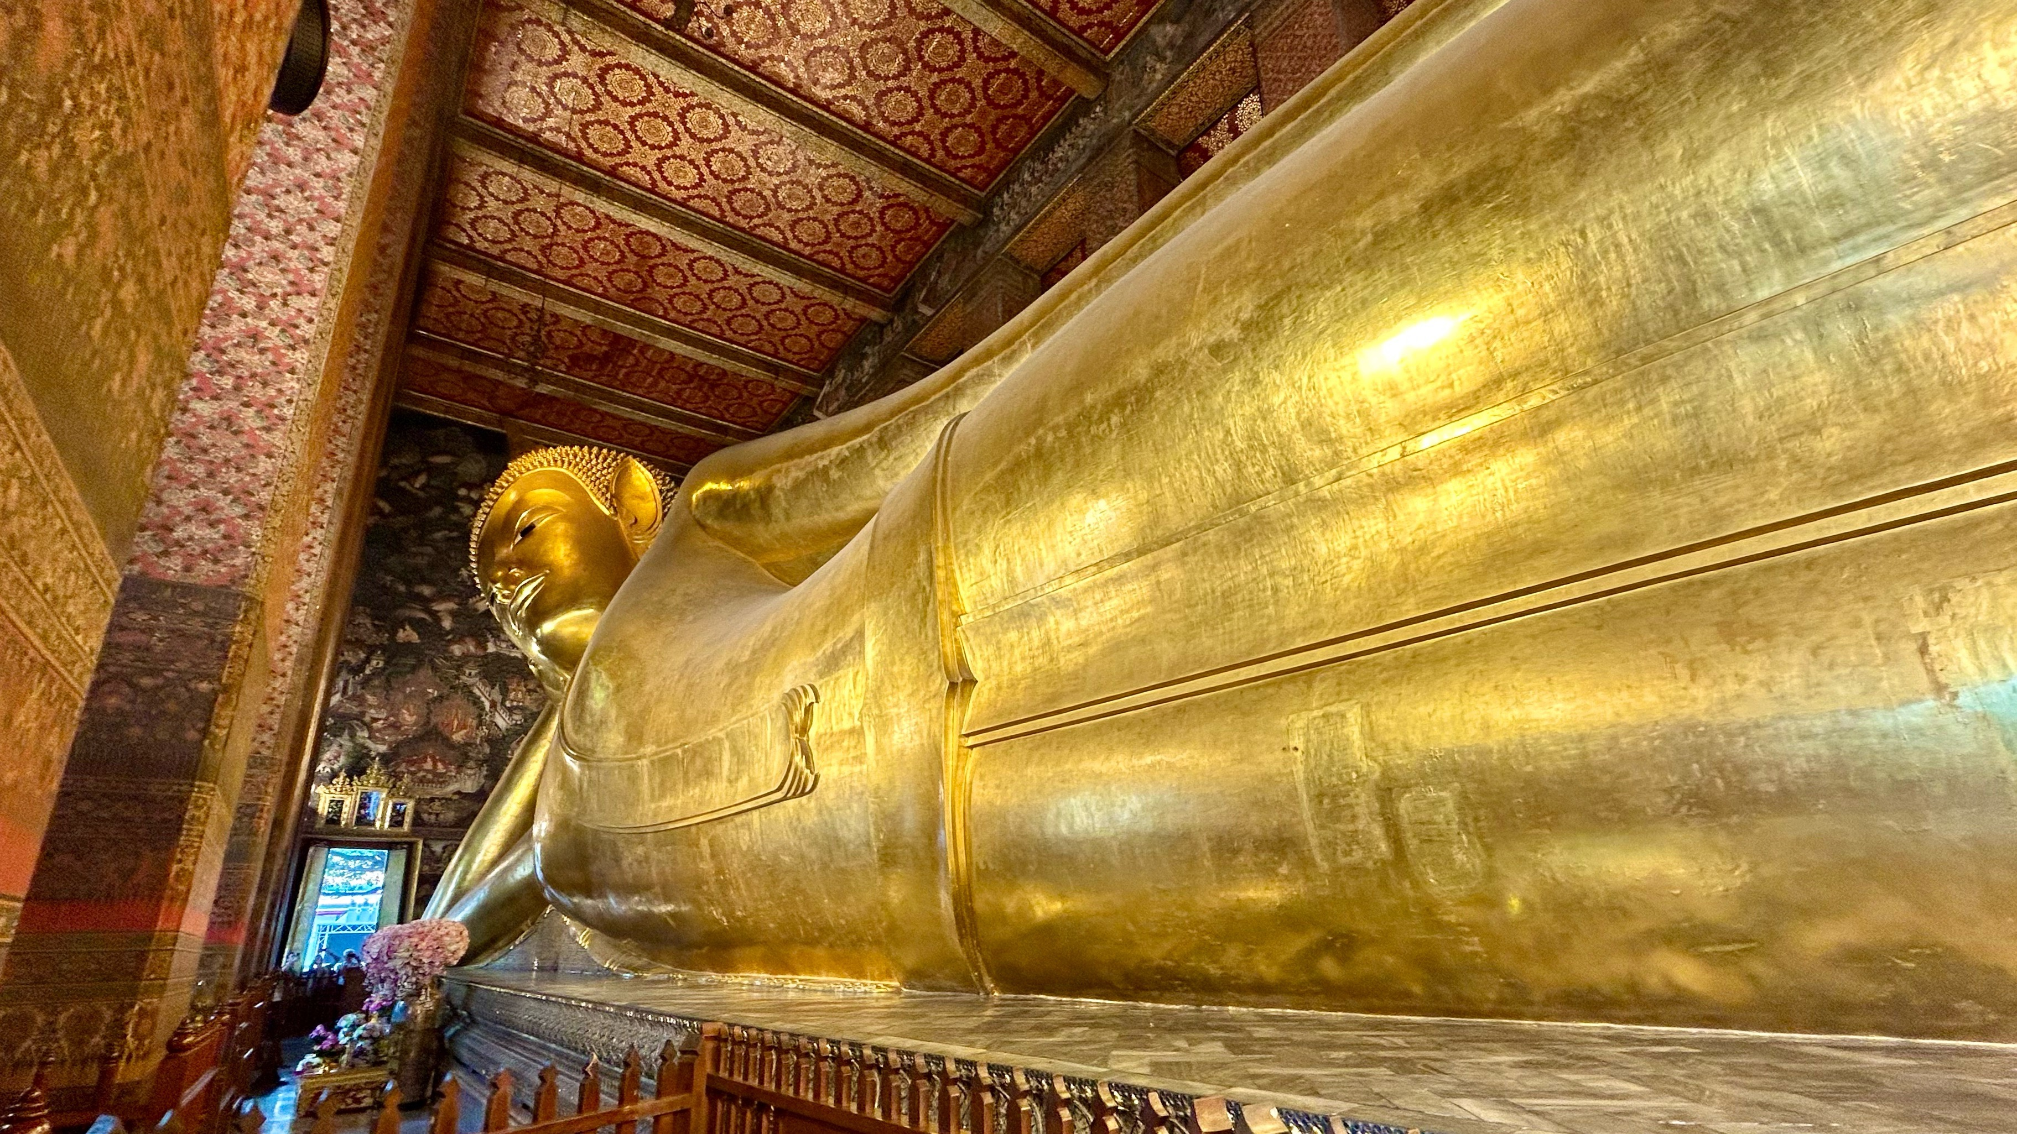
Featured Fitness and Activities- meditation/ breath work, yoga, excursions to Buddhist temples, personal lessons on Buddhist philosophy, mindfulness exercises
Featured Treatments and Medical- Consultation with a traditional Thai doctor, Thai massage, Thai poultice massage, acupuncture, and herbal/ tea medicine
Featured F&B- Healthy, Trivananda grown/ farm to table, Thai cuisine.
Thai cooking classes and the art of food as medicine from the perspective of traditional Thai food, Thai herbs and teas

Slide 3

Daily schedule:
7am-8am: Meditation
8:30am: Light breakfast (optional)
10am-12am: Visit to local Buddhist temple/ give offerings/ meditation/ spiritual talk
12:30pm Healthy vegetarian lunch
3pm-4pm: Mindfulness exercise/ yoga/ qigong
Tai chi
5pm: Healthy dinner
7pm-8pm: Traditional Thai medicine treatment/ massage

Slide 4
Spirit of Thailand Entitlements by day (3-night program)
Arrival Day | Day 2 | Day 3 | Departure day
Initial consultation (60 min) | Meditation (60min) | Meditation (60min) | Final Meditation (60min)
Spa treatment (60min) | Buddhist offerings/ ceremony/ meditation (120 min) | Buddhist offerings/ ceremony/ meditation (120 min) | Final consultaion (30min)
 | Mindfulness exercise (60min) | Mindfulness exercise (60min)
 | Spa treatment (60min) | Spa treatment (60min)

Slide 5
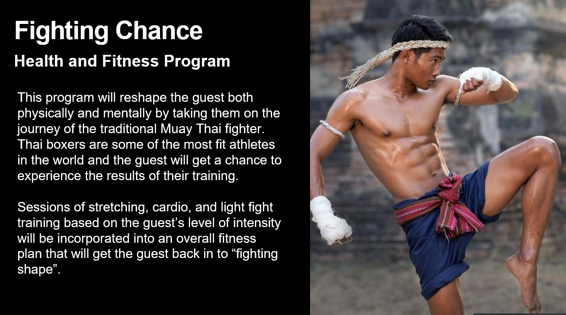
Fighting Chance
Health and Fitness Program
This program will reshape the guest both physically and mentally by taking them on the journey of the traditional Muay Thai fighter. Thai boxers are some of the most fit athletes in the world and the guest will get a chance to experience the results of their training.
Sessions of stretching, cardio, and light fight training based on the guest’s level of intensity will be incorporated into an overall fitness plan that will get the guest back in to “fighting shape”.

Slide 6

Featured Fitness and Activities- Muay Thai classes, learning the culture of Muay Thai (including the Wai Kru ceremony), private fitness sessions (including stretching, weights, and cardio), hikes and outdoor training, and meditation and breath work. The program may also include a trip to an outside Muay Thai training facility and/or a Thai boxing match as an additional excursion.
Featured Treatments and Recovery- Treatments such as Thai massage, full body massages, acupuncture and cupping, Thai poultice massage, hydro-therapies, and Thai herbal medicine and teas.
Featured F&B- The focus will be on healthy, locally grown/ farm to table, Thai cuisine, and Thai herbal medicine and teas

Slide 7
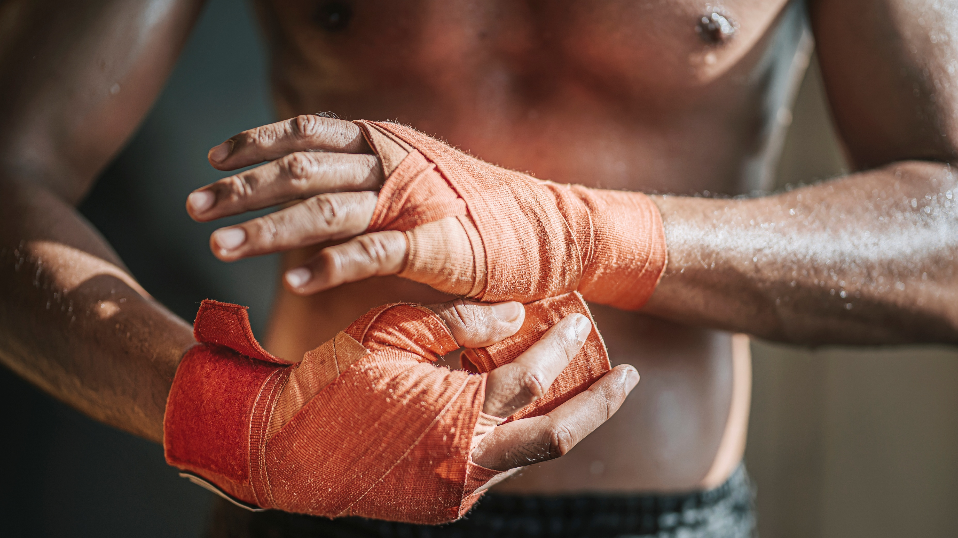
Example Daily Schedule:
7am-8am: Cardio work
8:30am: Light breakfast
10am-12pm: Muay Thai ceremony/ breathwork/ fight training/ stretching
12:30pm Healthy lunch
3pm-4pm: Traditional Thai medicine treatment
5pm: Healthy dinner
7pm-8pm: Spa treatment

Slide 8
Fighting Chance Entitlements by day (3-night program)
Arrival Day | Day 2 | Day 3 | Departure day
Initial consultation (60 min) | Cardio work (60min) | Cardio work (60min) | Closing ceremony/ Meditation (60min)
Fitness assessment | Ceremony/ Muay Thai training (120 min) | Ceremony/ Muay Thai training (120 min) | Final consultaion (30min)
Spa treatment (60min) | TTM treatment (60min) | TTM treatment (60min)
 | Spa treatment (60min) | Spa treatment (60min)

